Slide 1

Exploratory Data Analysis on Steam Games
By : Vishal Veeraraj Shetty - 1RN19IS178
Yash S Sindhe - 1RN19IS186

Slide 2
Abstract
Exploratory Data Analysis refers to studying of past data to watch the change in trends of different categories of gaming over the years.
The trends are reflected in the form of graphs and the games are categorized as single player and multiplayer in the form of a bubble chart.
An EDA report is then used by Data Scientists to understand patterns/anomalies , understand relationships between datasets and make conclusions.
We used Google Collaboratory as the python environment to perform the data operations as well as used libraries like Pandas and Numpy.

Slide 3
Literature Survey
Big Data Analytics: A Literature Review Paper:
Authors: Nada Elgendy, Ahmed Elragal, German University in Cairo, Egypt
Date: August 2021
Abstract:
In the information era, enormous amounts of data have become available on hand to decision makers. Big data refers to datasets that are not only big, but also high in variety and velocity, which makes them difficult to handle using traditional tools and techniques.
Due to the rapid growth of such data, solutions need to be studied and provided in order to handle and extract value and knowledge from these datasets.

Slide 4
Literature Survey
Big Data Analytics: A Literature Review Perspective:
Authors: Sarah Al-Shiakhli, Lulea University of Technology, Sweden
Date: August 2020
Abstract:
Due to rapid increase in big data, solutions to handling data and extracting knowledge from datasets need to be developed. Techniques such as Exploratory Data Analysis helps in analyzing massive quantities of data which will aid decision makers in making the right decisions that could help the business prosper.
These techniques are not limited to certain domains as they don’t have any domain restrictions. As long as there is data, knowledge can be extracted and analyzed irrespective of domain.

Slide 5
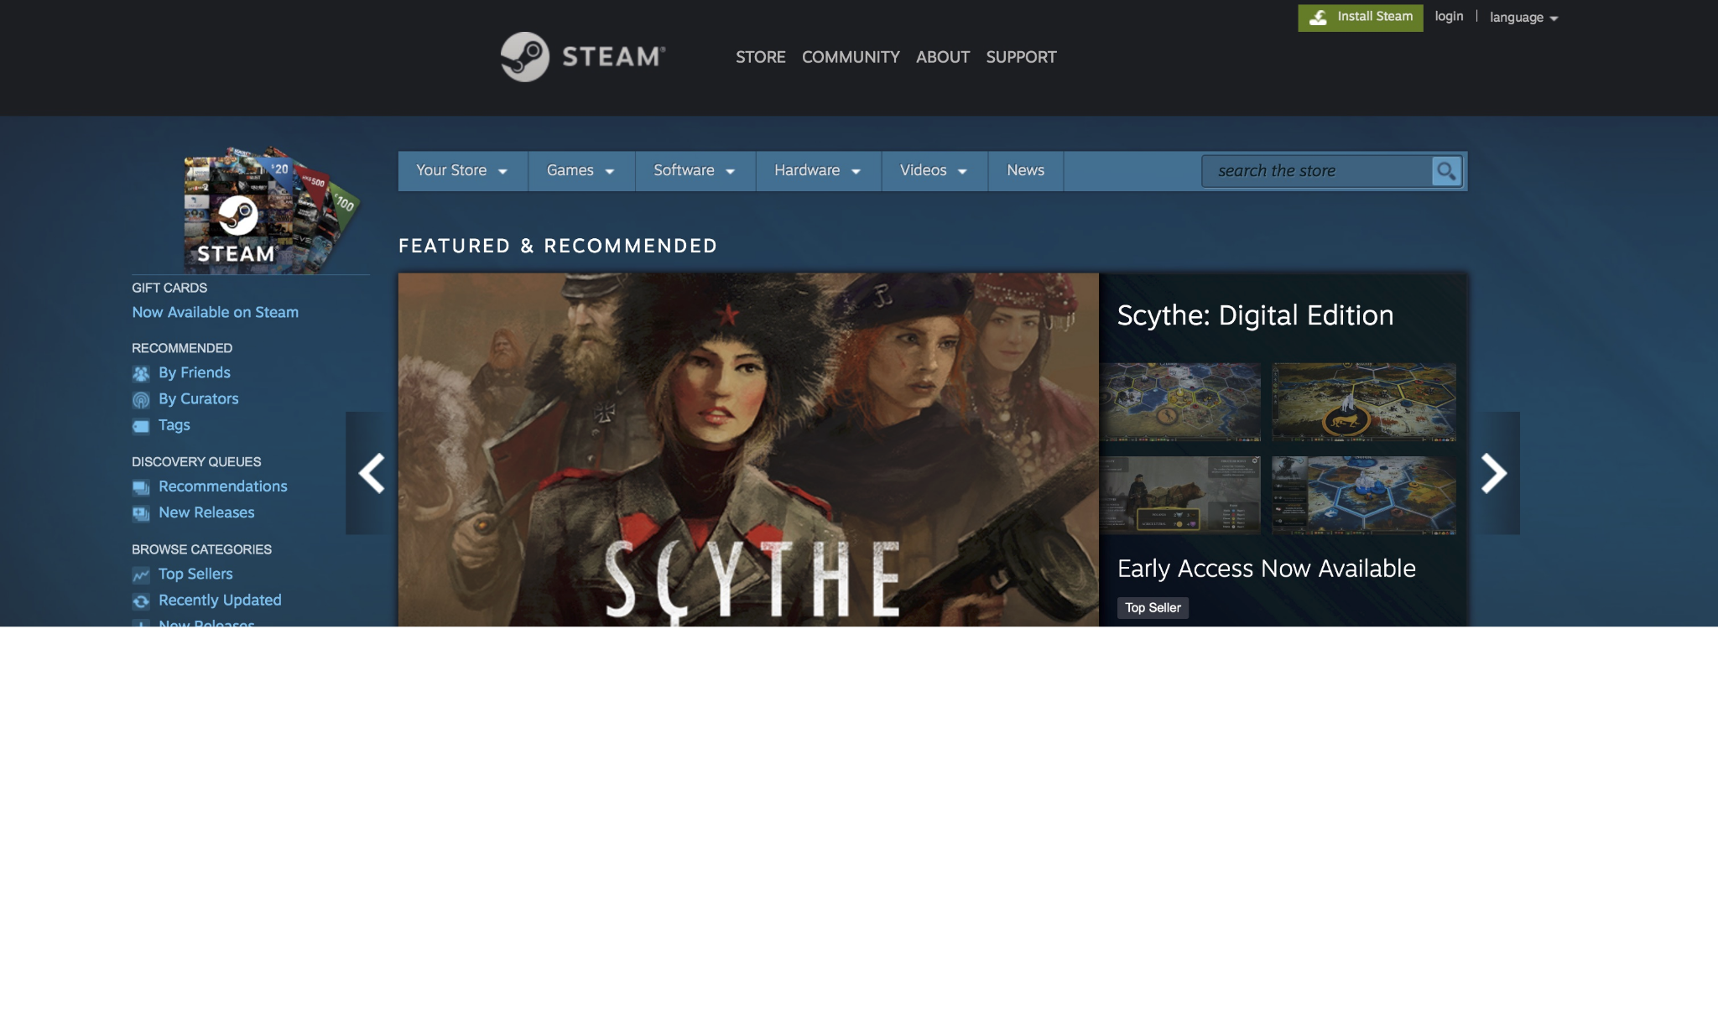
Introduction
Video games have evolved drastically since the 90s. They have now become a very popular medium for storytelling and entertainment competing with the likes of the movie industry.
From two dimensional games to open world 3-dimensional games, games have become nearly identical to real life due to advances in graphics and interactivity.
Steam is a video game digital distribution service founded by Valve in 2003. It is a platform where game developers and studios can publish their creative work for people to buy.
Due to rich features and good deals, Steam has become one of the most popular platform for both game devs as well as gamers.

Slide 6
System Design
Gathering Raw Data
Kaggle
Data Cleaning
Python - Pandas, Numpy
Data Processing
Pandas
Data Visualization
Tableau

Slide 7
Gathering Raw Data
The dataset containing raw data is taken from Kaggle (A dataset repository) which is maintained by a community of users.
The dataset is generated by using Steam and SteamSpy APIs.
The initial dataset is raw and contains many missing and null values which need to be cleaned.

Slide 8
Data Cleaning
Currently the downloaded data is not in a very useful state. Many of the columns contain lengthy strings or missing values, which hinder analysis and are especially crippling to any machine learning techniques we may wish to implement.
Data cleaning involves handling missing values, tidying up values, and ensuring data is neatly and consistently formatted.
We use pandas library as well numpy from python to perform data manipulation as well as creating the dataframe.

Slide 9
Data Processing
Once null, missing and duplicate values are removed, we start processing the columns in the dataset.
We check for data-type mistakes as well as removing columns that is not necessary for visualization.
This step essentially reduces the overall size of the dataset as unwanted columns are removed and only those that are going to be visualized are kept.

Slide 10
Data Visualization
Data visualization is done through BI tools like Tableau, Microsoft Power BI etc.
These tools take the dataset and allow us to plot interactive graphs as well as create interactive dashboards.
The dashboard allows us to have a visual representation of the data and make it easier to read/understand it. This enables us to see trends and patterns.
This is the final step in the data analytics process.

Slide 11
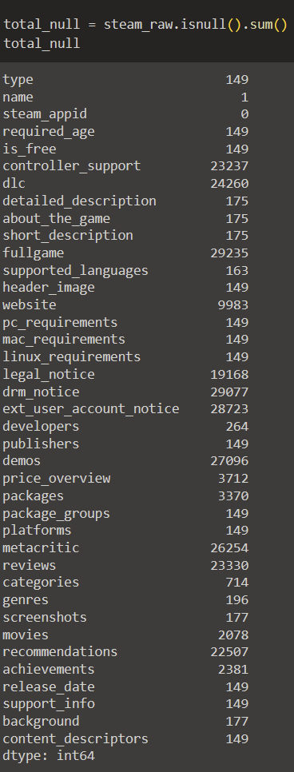
Implementation
Finding no of null values
isnull() - checks whether null values are present
.sum() - summation of all values

Slide 12
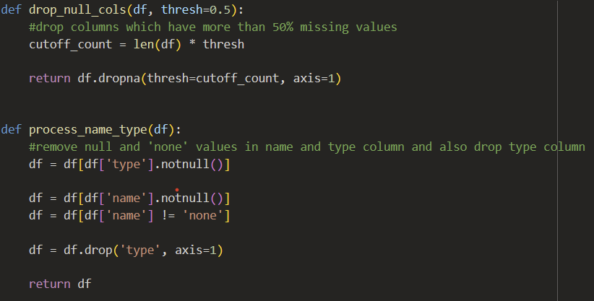
Implementation
Dropping columns based on threshold & cleaning name column

Slide 13
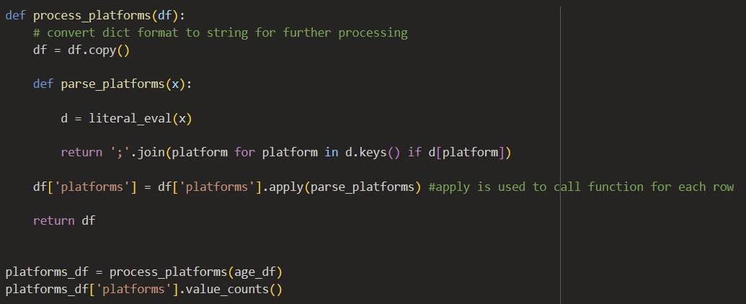
Implementation
Converting data-type of platform column

Slide 14
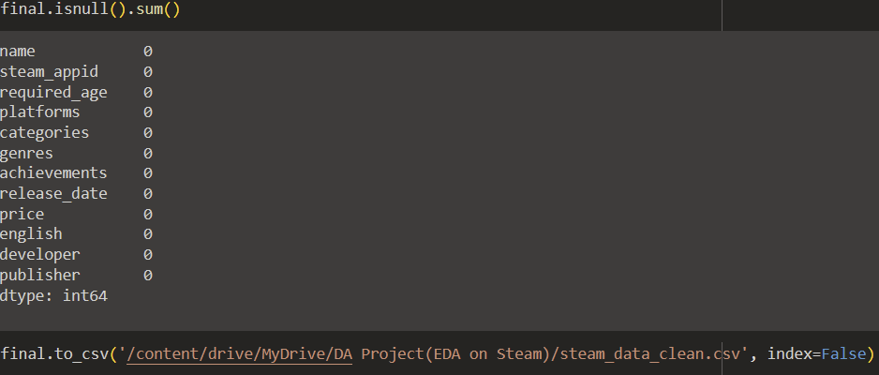
Implementation
Final check for null values & exporting the dataset

Slide 15
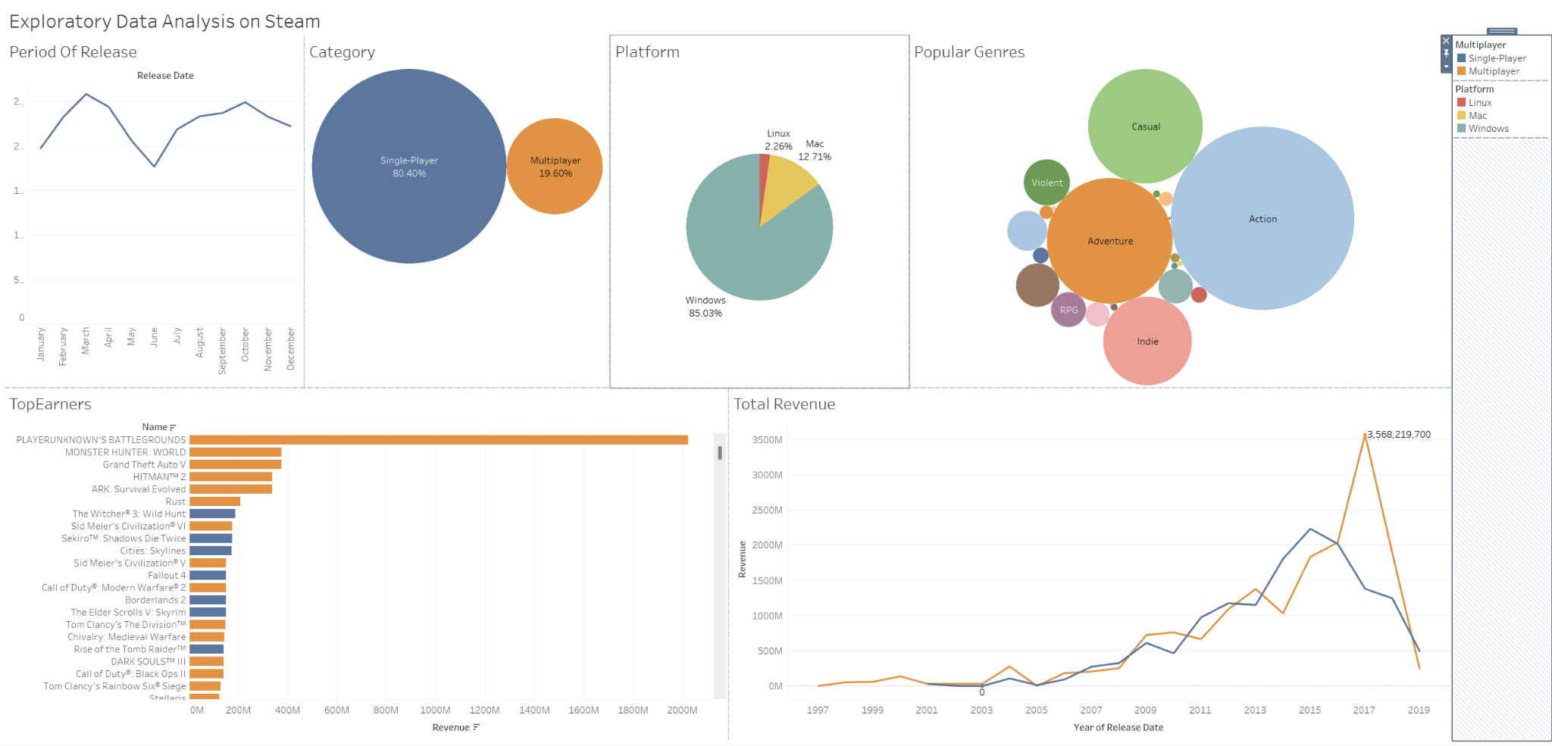
Result

Slide 16
Conclusion
98% of the games are released in English.
Windows is the most preferred and popular platform to release games in.
Single player games is the most popular category but multiplayer games bring in more revenue.
Most single player games are released during the month of March followed by October whereas most multiplayer games are released during August and October.
Action and Adventure are the most popular genres among users.
Top 5 most owned games are all multiplayer with PUBG being the only one with a price tag.

Slide 17
Future Enhancements
Creating a system that involves automatic data collection via Steam and SteamSpy APIs
Creating a frontend and backend system to provide real-time analytics.
Utilizing ML models to generate future trends and patterns.

Slide 18
Thank You

